Slide 1
Predicting Employee Attrition
Based on Sailfort Motors (fictional company and dataset)

Slide 2
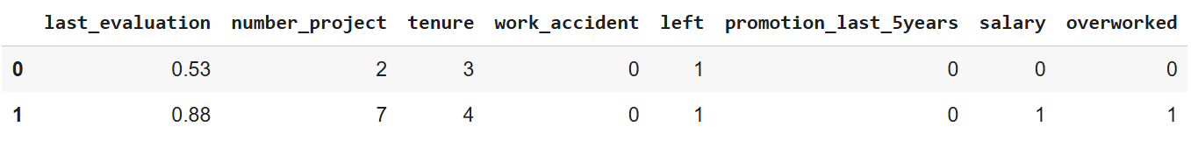
The Task and Available Data
Problem Statement
Sailfort Motors wants to be able to predict whether an employee will quit, in order to better reduce attrition likelihood and ensure resource utilization is optimized for employees who will remain.
Why This Matters
High attrition increases hiring and training costs, as well as reduces long-term value of resources invested in employee development.
Improved attrition predictive ability can better help HR to intervene amongst employees/employee groups at greatest attrition risk.
Data
~11,000 complete employee data points
16 variables were included, with most relevant variables shown in Figure 1, below.
  Salary was previously coded into low, medium, and high values by Sailfort Motors.
  Receipt of promotion was coded to binary for 1 = yes, 0 = no.
  Overworked was coded as 0 = no, 1 = yes, based on whether average work hours per month exceeded a rate of 40 hours/week.
  The main outcome variable is ‘left’, coded as 0 = stayed with company, 1 = left company.
Figure 1. Representative sample of 2 employees from overall data, excluding department assignments.

Slide 3
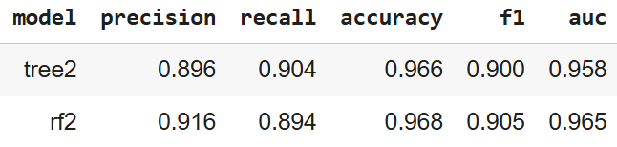
Model Selection and Evaluation
The outcome variable is binary, so decision tree and random forest models are appropriate.
GridSearchCV was used, refit to auc and cross-validated with 4 folds.
Scoring metrics: precision, recall, accuracy, f1, ROC area-under-curve (auc).
  ROC-AUC was used as the metric of interest due to a mild imbalance between number of employees who stayed and number who left.
Data train/test split %: 75/25
Employee satisfaction was omitted from final model due to being inconsistently tracked and largely colinear with attrition.
Notable Metrics
  Precision: High precision helps avoid false positives, saving resources on unnecessary intervention.
  Recall: High recall helps avoid false negatives, ensuring timely intervention with employees at risk of leaving.
  F1: A high F1 score means a good balance between precision and recall, ensuring the model captures true leavers while avoiding excessive false positives.
  ROC-AUC: A high AUC value means the model reliably ranks employees likely to leave higher than those likely to stay, regardless of category-assignment threshold.
The Random Forest model (rf2) outperforms the decision tree (tree2) in all metrics, except recall, seen in Figure 2.
Figure 2. Performance scores from the best estimators of decision tree and random forest classification models.

Slide 4
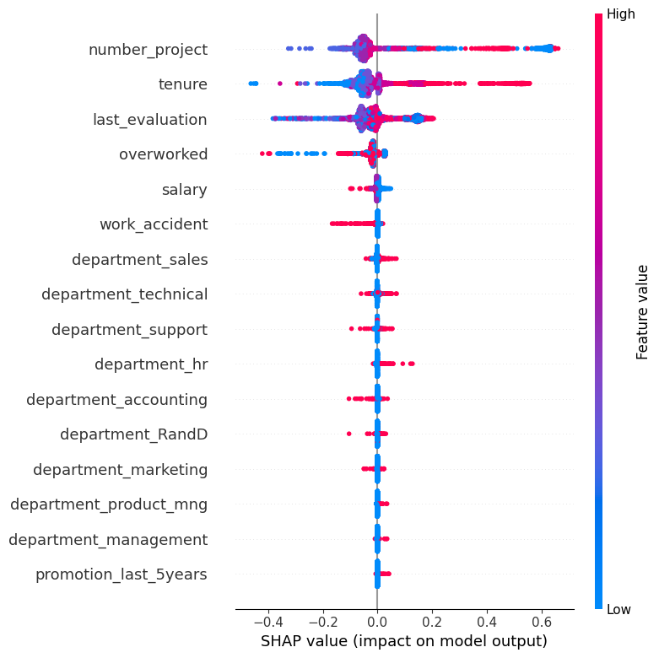
Individual Predictor Importance
SHAP values, seen in Figure 3, display the relative contributions of each predictor to the final model outcome.
  Quantifies how each variable pushes an individual prediction higher or lower (0 = stay, 1 = leave).
For an individual employee, the number of projects assigned, their tenure, their last evaluation score, and whether they are classified as overworked (> 175 monthly hours).
Notably, an employee’s salary and whether they have received a promotion within the last 5 years are weak predictors of attrition.
Figure 3. Bee swarm plot of all predictors, colored by their intra-variable value, based on their impacts on model prediction.

Slide 5
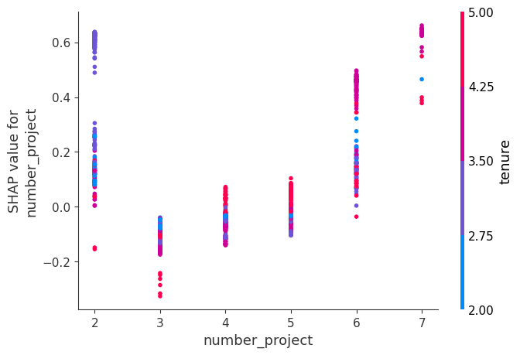
Individual Predictor Importance – Number of Projects
SHAP dependence values for number of assigned projects, seen in Figure 4, indicate that attrition risk is lowest for employees assigned 3-5 projects.
  Work underload and overload both seem to increase attrition risk.
Coloring by tenure suggests that employees assigned 2 projects tend to have a shorter tenure, and employees assigned 6-7 projects tend to have a moderate to longer tenure.
Figure 4. Dependence plot on the effect of the number of projects assigned on attrition prediction.

Slide 6
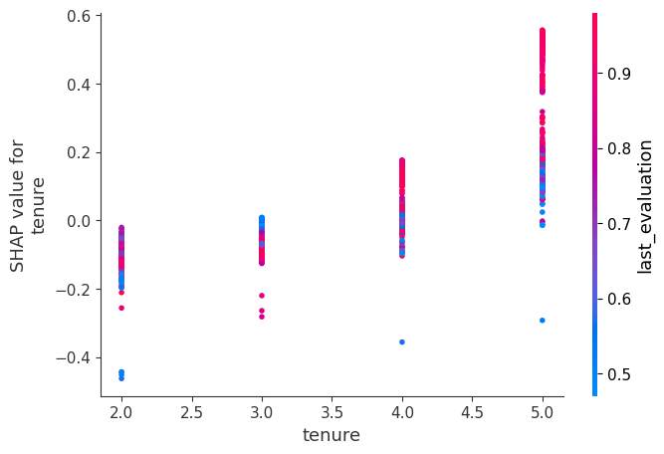
Individual Predictor Importance – Tenure
SHAP dependence values for tenure, seen in Figure 5, indicate that attrition risk generally increases with tenure.
Additionally, when considering the interaction with employees’ last evaluation scores, attrition risk increases with both tenure AND evaluation score.
Figure 5. Dependence plot on the effect of tenure on attrition prediction.

Slide 7
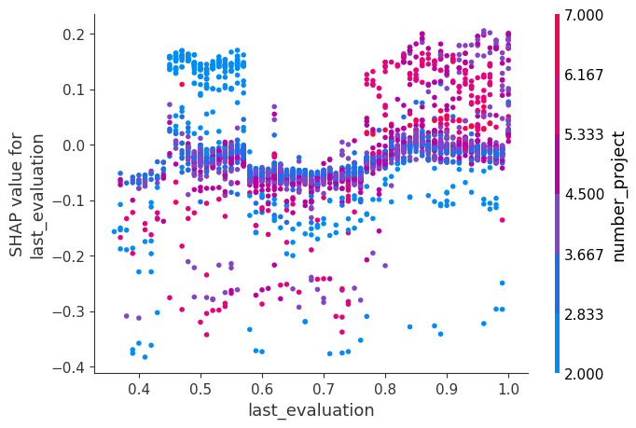
Individual Predictor Importance – Last Evaluation Score
SHAP dependence values for last evaluation scores, seen in Figure 6, indicate a somewhat bimodal increase in attrition risk.
  Employees with low evaluation scores and low project assignments are at increased risk, as are employees with high evaluation scores and high project assignments.
The interaction with number of assigned projects is less clear in the midrange of evaluation scores, although it reflects a more stable, lower-risk pattern.
Figure 6. Dependence plot on the effect of employees’ last evaluation scores on attrition prediction.

Slide 8
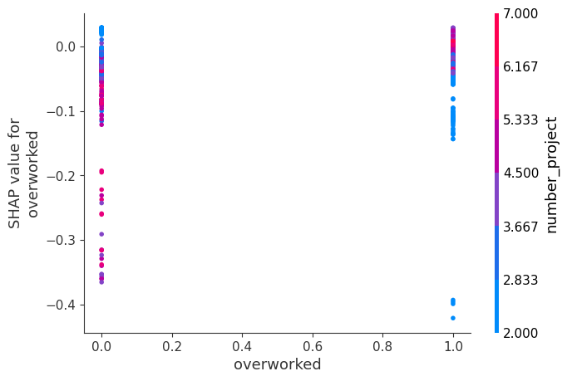
Individual Predictor Importance – Last Evaluation Score
SHAP dependence values for whether an employee is overworked (>175hr/month), seen in Figure 7, do not indicate a significant pattern on attrition risk, in alignment with the bee swam plot seen previously.
Number of assigned projects was selected as the strongest interaction by default when building the plot. Nevertheless, color distribution shows no meaningful interaction
Figure 7. Dependence plot on the effect of employees being overworked on attrition prediction.

Slide 9
Recommendations for Sailfort
To proactively reduce attrition, assign employees 3-5 projects, as operations allow.
  Avoid underloading short-tenure employees (≤2 projects).
Intervention should be prepared for:
  Long-tenure employees, particularly those who achieved high scores on their last evaluation.
  Employees who received low last-eval scores in conjunction with fewer assigned projects and employees who received high last-eval scores in conjunction with many assigned projects
“Employee satisfaction” was originally included as a predictor in the model and did improve model performance. It was omitted from the final model on the basis that it is not reliably tracked, and it is generally very closely related to interindividual attrition likelihood.
  Future versions of this model may attempt to include this again as a metric, although care should be taken to ensure it is tracked in a way to reduce bias (ensure as many employees complete a satisfaction assessment as possible and evaluate it at regular intervals).

